Slide 1

How Can Airbnb Hosts Improve their Profitability and Ratings ?
By – Jeffrey Mychalchyk, Luke Iorio, Prajakta Gaikwad

Slide 2
Strategy and Metrics:
Airbnb Hosts:
All property owners in the US who have listed their properties on Airbnb.
Everyone in the US who is intending to invest in Airbnb properties.
Profitability:
Airbnb earnings based on the number of reviews on a listing and their nightly price.
Ratings:
Number of Reviews on Airbnb
Average aggregated ratings on the 0-100 scale (ratings can be divided by 20 to get star ratings on a 0-5 scale)
In this project, we have organized and analyzed a database of around 74,000 listings in 6 cities in the US; in an attempt to discover any trends on how Host Profits and User Ratings vary across Locations, Property Types and Amenities.

Slide 3







Data Source
Data Exploration, Cleanup, Analysis and Visualization Tools:
Collaboration Tools:

Slide 4
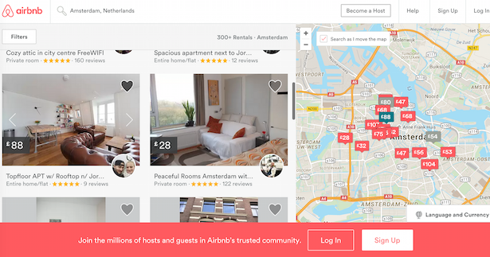
Location Analysis
What cities have the most listings?
What cities have the highest nightly price on average?
Which city brings in the most revenue?
Where do Airbnb hosts make the most money?
Do user ratings vary across different locations?

Slide 5
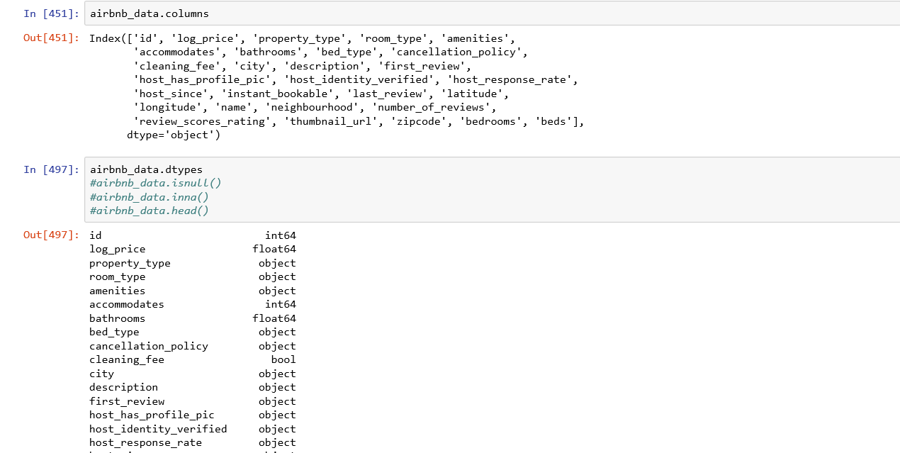
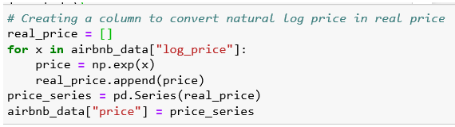
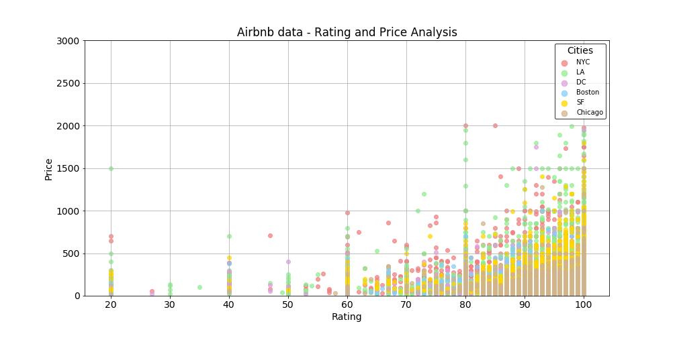
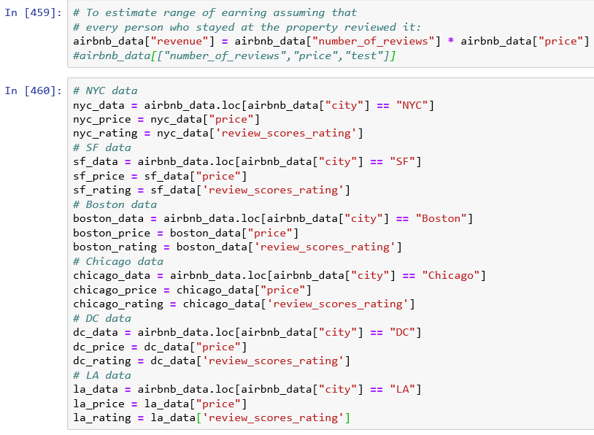
Data Cleanup and Exploration

Slide 6
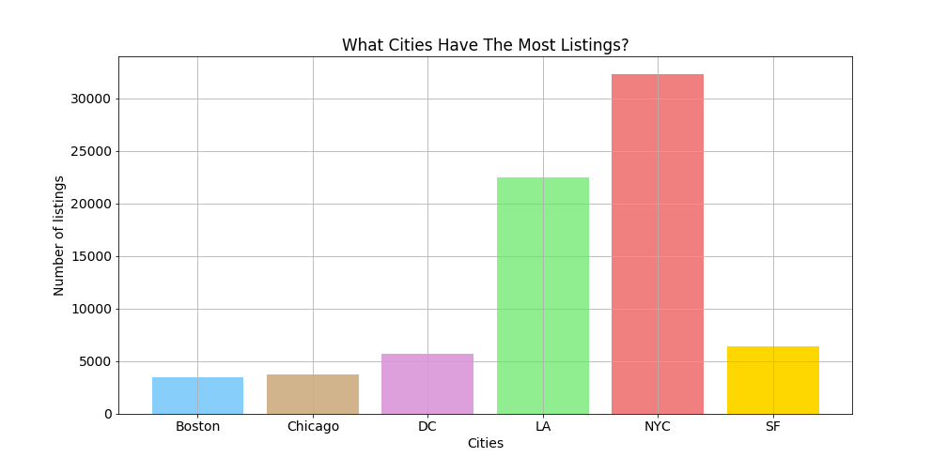
Density of listings is much higher in New York followed by Los Angeles than in any other cities. (32,349 and 22,453 respectively)

Slide 7
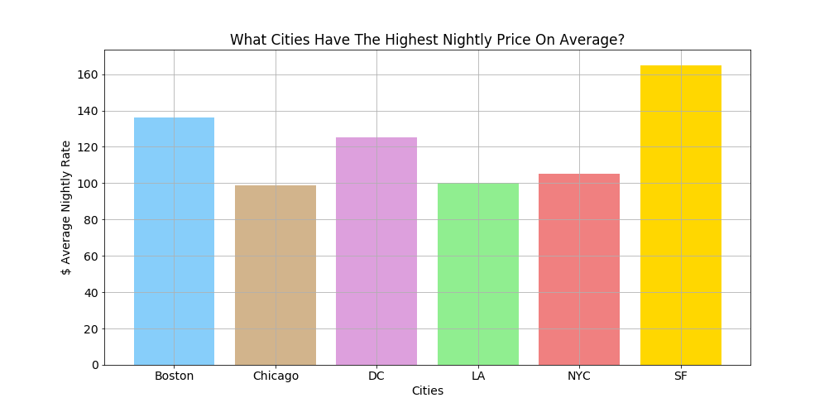
San Francisco has the highest nightly price of around $ 165
It is also observed that cities with more listings tend to have lesser nightly price and vice versa

Slide 8
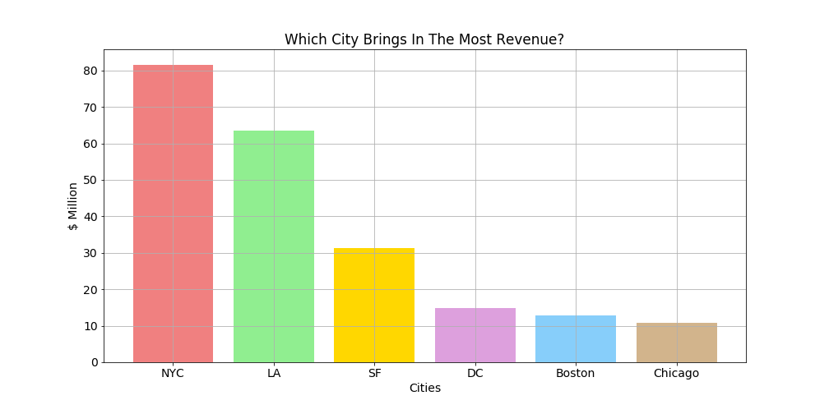
With the highest number of listings and more than $ 80 Million revenue New York is clearly one of Airbnb’s biggest markets.

Slide 9
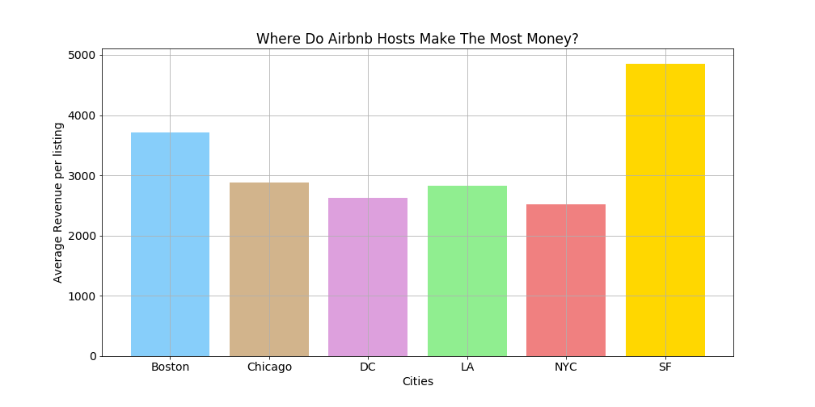
Average earnings per host is the highest in San Francisco (around $ 5000)

Slide 10
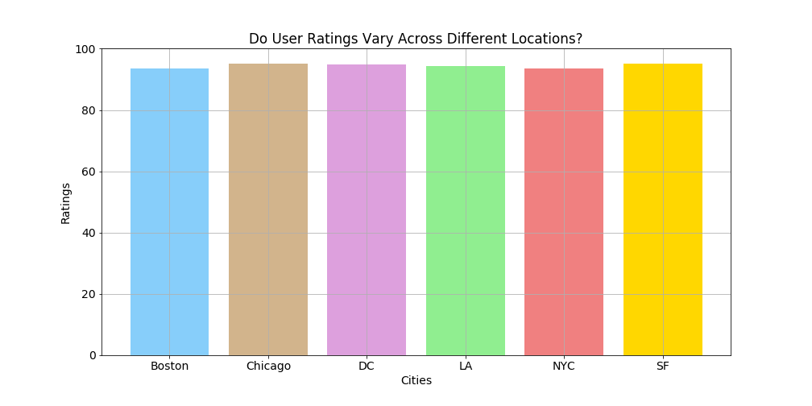
On an average all cities seem to have similar ratings. The location of the listing clearly has no impact on the ratings.

Slide 11
Property Type Analysis
What property types have the most listings?
How does the price of the rental space get affected by its property type?
Do property types affect user ratings?

Slide 12
Property Type Data Cleaning
Separate the data based upon the property type
Pull the data that was only from the top five properties (apartment, house, condo, townhouse, loft)
Exclude the properties that had fewer than ten user ratings

Slide 13
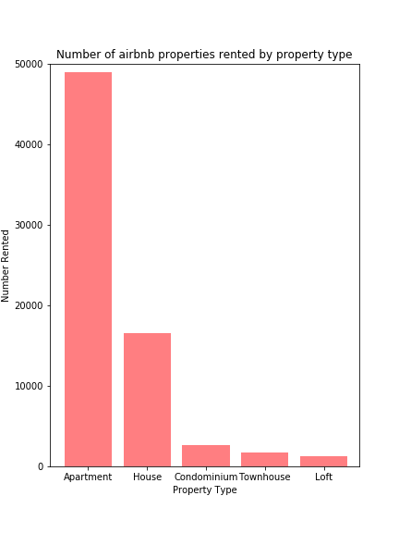
Properties Rented by Property Type
Apartment - 49,003
House - 16,511
Condo - 2,658
Townhouse - 1,692
Loft - 1,244
68.9% apartment
76.8% non-house properties

Slide 14
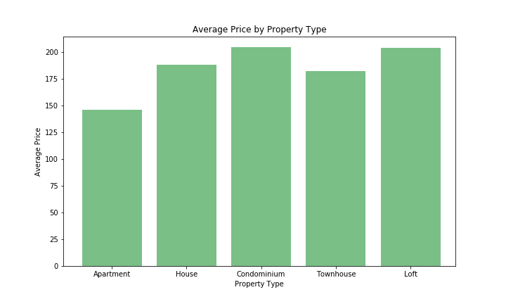
Average Price by Property Type
Apartment - $146
House - $188
Condo - $204
Townhouse - $182
Loft - $203

Slide 15
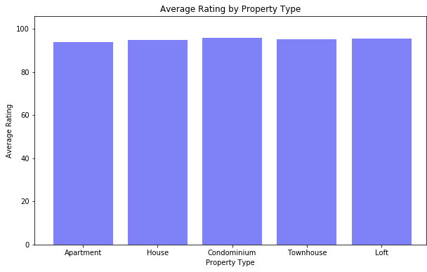
Average Rating by Property Type
Apartment - 93.8
House - 94.8
Condo - 95.9
Townhouse - 95.2
Loft - 95.3

Slide 16
Amenities Analysis
Does inclusion of certain amenities correlate with a higher customer rating?
Does inclusion of certain amenities have any noticeable effect on customer ratings for different property types?
Does inclusion of certain amenities have an effect on the price for different property types?

Slide 17
Process of Cleaning Amenities Data.
All amenity data was in an object containing individual text description.
Data had to be converted to a count of individual descriptions.
Multiple descriptions from different sources for the same amenity.
Parking, Free Parking on premises.
Undefined Amenities
Translation missing: en.hosting_amenity_49,50 etc.. ,Flat.
Many amenities could be grouped together in the same group.
Accessible
Shower seat, Fixed grab bars for shower & toilet,Roll-in shower with chair, Wide doorways.
Baby Friendly
Pack ’n Play/travel crib, High chair, Stair gates, Crib.
Pet Friendly
Pets Allowed, Cats allowed, Dogs allowed, Other pets.
Notes:
Average overall rating, 1 click
Average Amenity Rating, 1 click
Count of user reviews, 1 click
Some Amenities stand out
beachfront higher review, 1 click
and more likely to be reviewed.

Slide 18
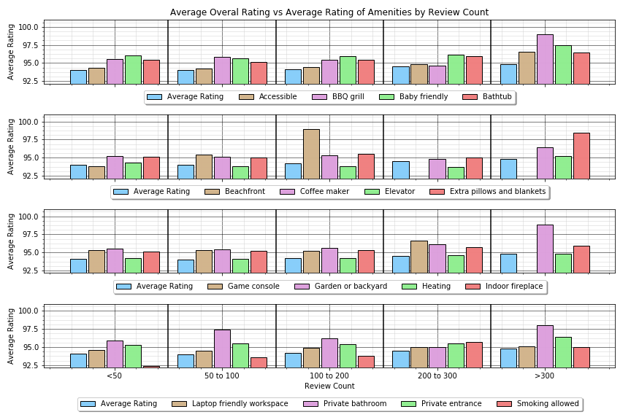
Does inclusion of certain amenities correlate with higher customer ratings?
Findings
Some amenities do seem to correlate to higher ratings.
Some seem to be expected and line up with the average
Average Amenity Rating
Average Overall Rating
Count of User Reviews

Slide 19
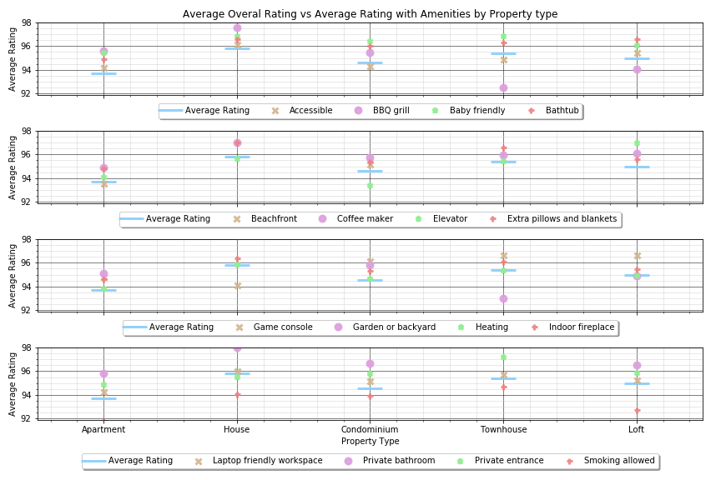
Does inclusion of certain amenities have any noticeable effect on customer ratings for different property types?
Findings
In some cases, amenities lower ratings. In this case having a BBQ would be great for a house but not for a townhouse.
Having a rental that allows smoking seems to consistently lower the rating.
Average Amenity Rating
Average Overall Rating
Property Type

Slide 20
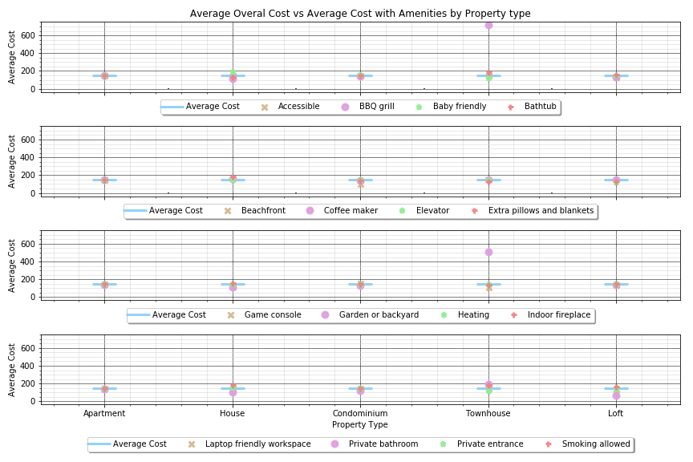
Does inclusion of certain amenities have an effect on the price for different property types?
Findings
Nothing really seems to make a difference in average with the exception of having a garden or backyard
Having a BBQ Grill looks to correlate with higher price but lower ratings for a townhouse. I would make an assumption that only upscale townhouses would have BBQ grills. That would have to be researched further.
Average Amenities Cost
Average Overall Cost
Property Type

Slide 21
Limitations in Analysis:
Airbnb rental supply isn’t static like hotel rooms, The fluidity of the short-term rental makes it incredibly complex to track.
Our data lacked information about host’s occupancy rate. Hence a range of earnings is an estimate based on the number of reviews on a listing and it’s nightly price.
We analyzed data for 6 cities in the US hence our results may not be generalizable to other cities in the US.
We include locations, property type and amenities, other features such as host response rate, cancellation policy, property description length could also be better indicators of user ratings.

Slide 22
Conclusion:
Based on our analysis, it is clear that Airbnb hosts are more likely to make the most money in San Francisco ($ 4856 per listing on average). Offering competitive rates will be important to be successful in New York market.
To be an Airbnb host you are no longer required to have large homes located primarily in rural vacation destinations, they can be apartments or houses with 1 or 2 bed units (68.9 % of the listings are apartments).

Slide 23
Conclusion (continued):
As a whole, the location of the property or its type does not affect how users might rate it however, properties with amenities such as a private bathroom, beachfront property and having a backyard tend to have higher ratings compared to others.

